Slide 1

CLOUD AND SERVERLESS COMPUTING PROJECT
Name : Chilukuri Sowmya
ID : 2100032530

Slide 2
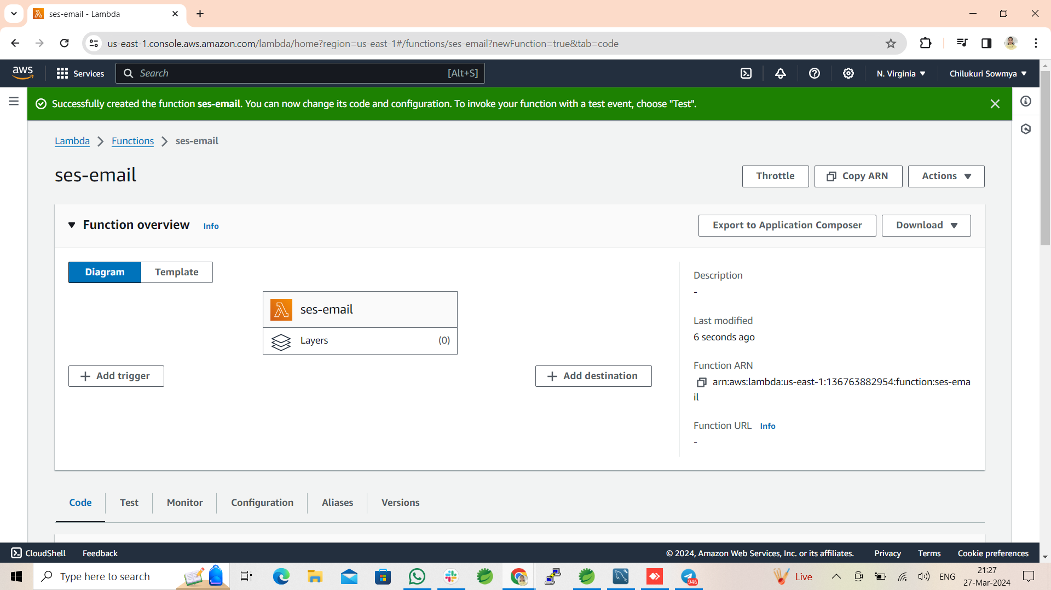
Topic : Sending Email Using AWS Simple Email Service
Step-1 : Create a Lambda Function

Slide 3
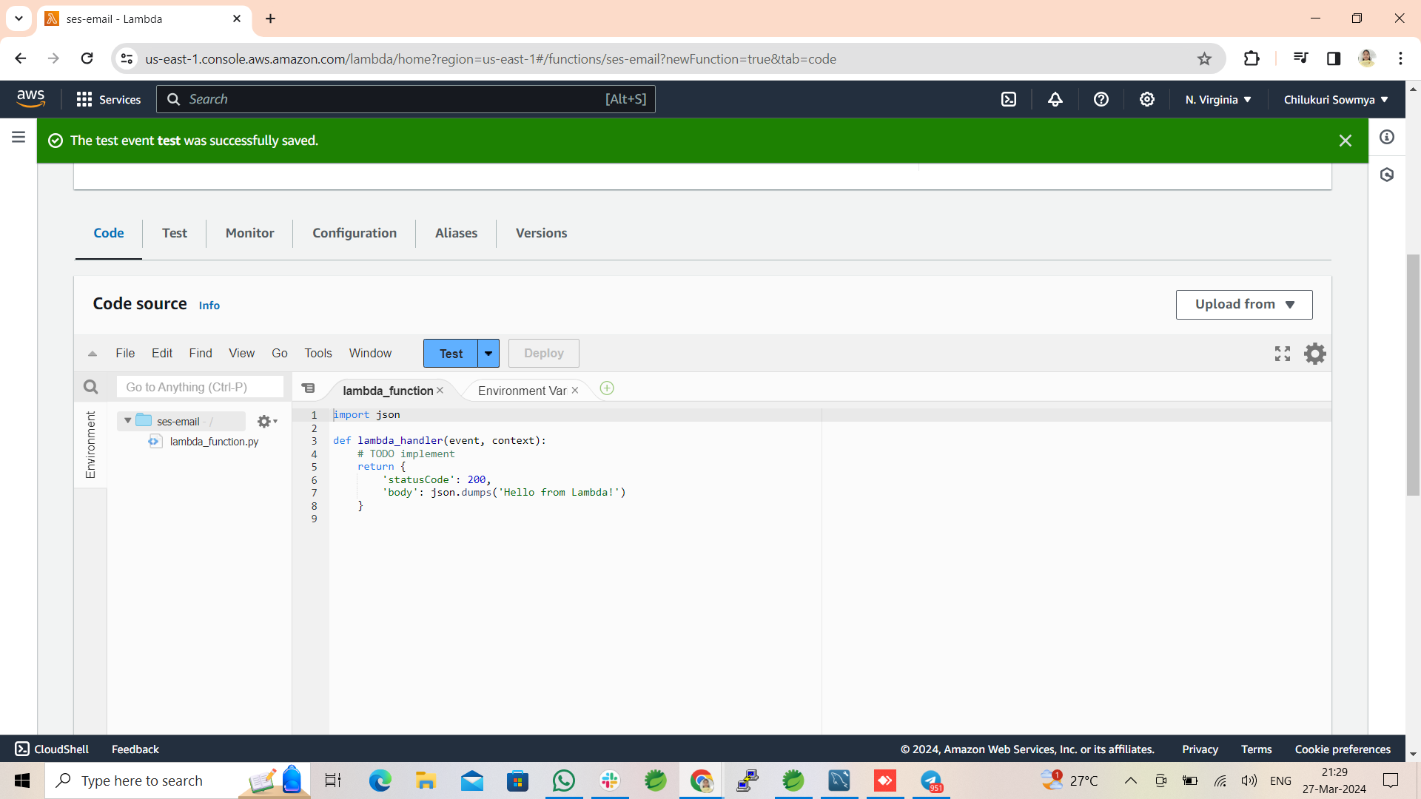
Step-2:Configure a test event and test the code

Slide 4
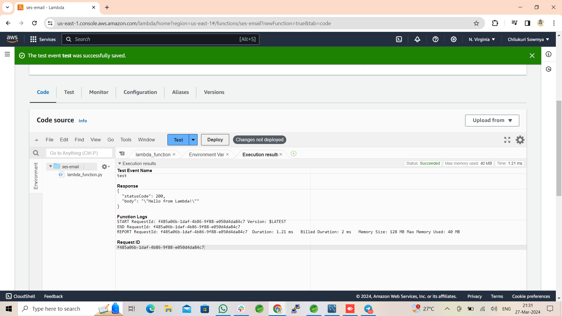
execution result after testing :

Slide 5
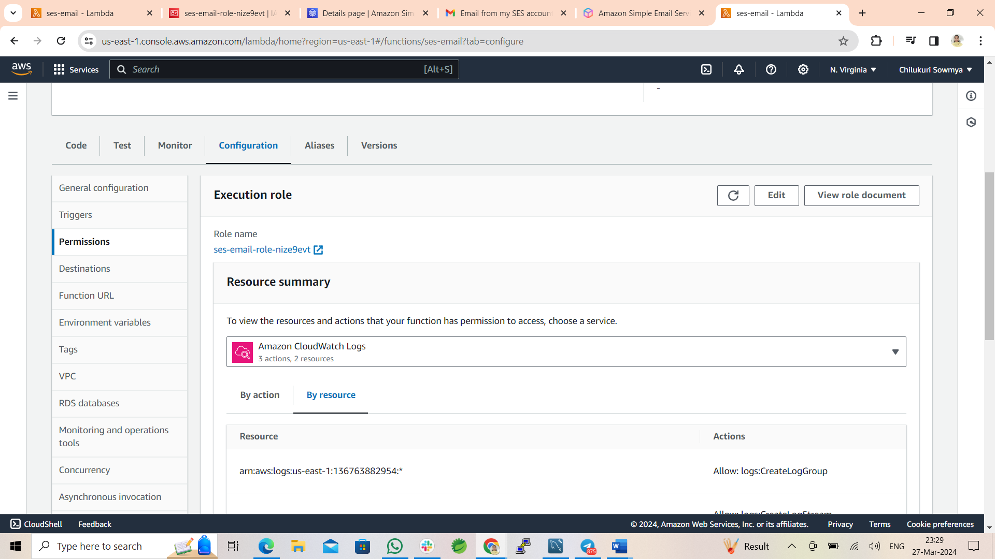
Step-3 : Go to Configurations and open execution role

Slide 6
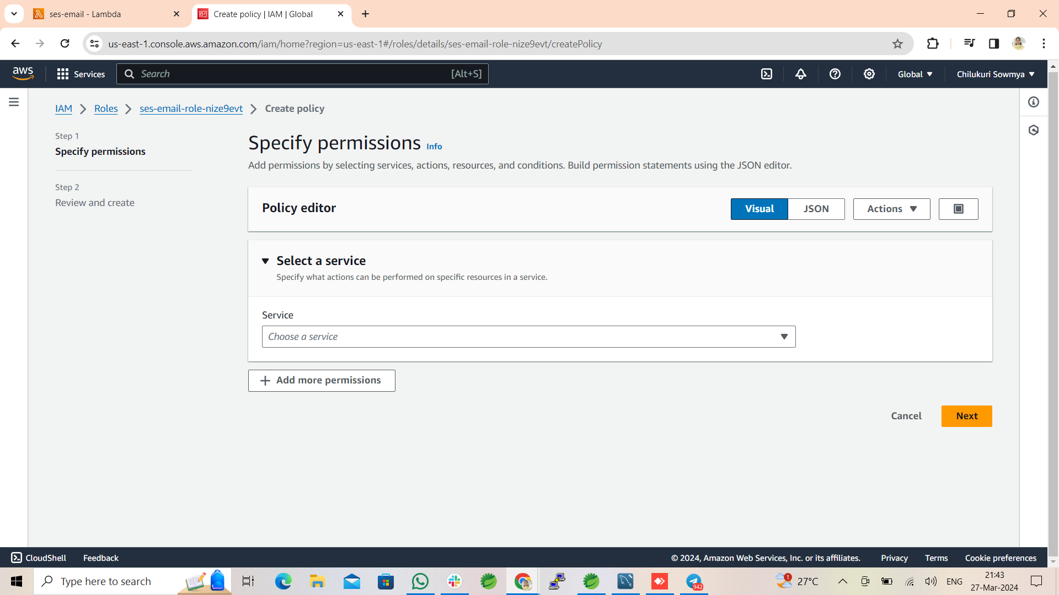
Step-4 : Click on add Permissions , select inline policy , search SES service and add services

Slide 7
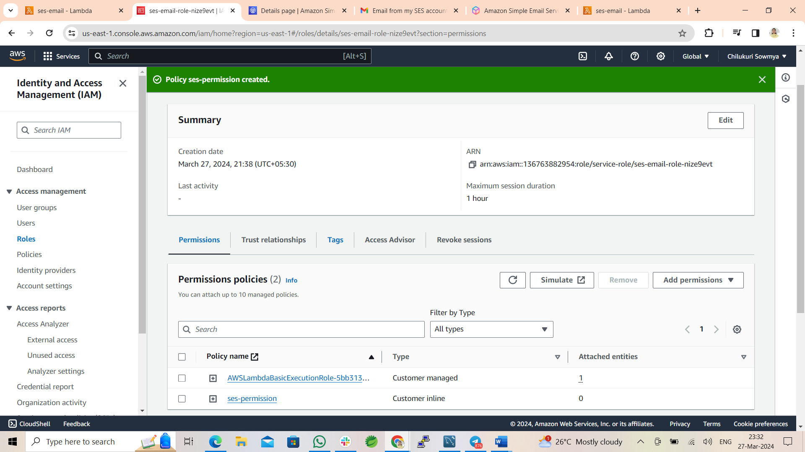
Policy created

Slide 8
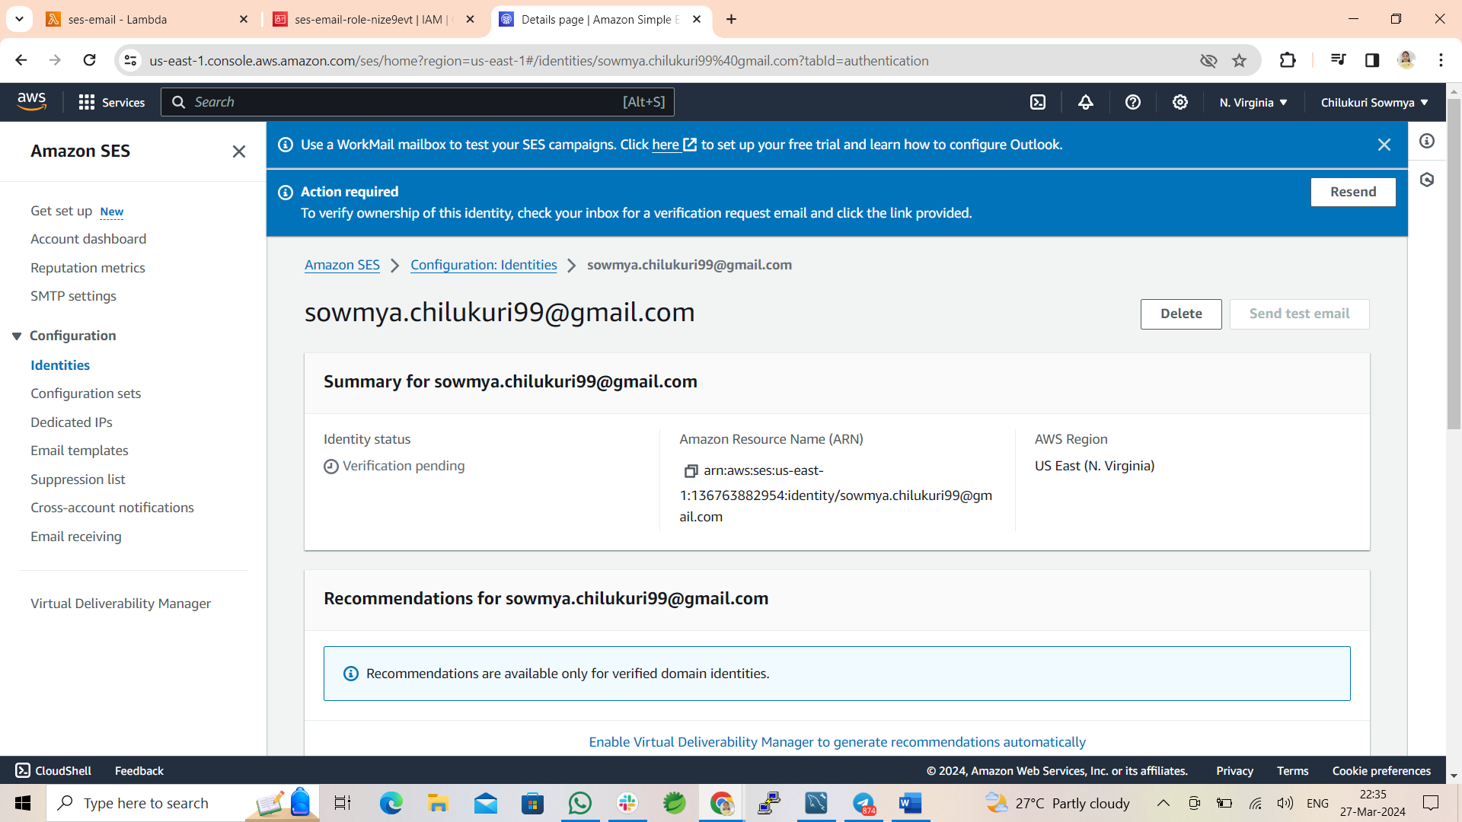
Step-5 : Open Amazon SES service and create an identity

Slide 9
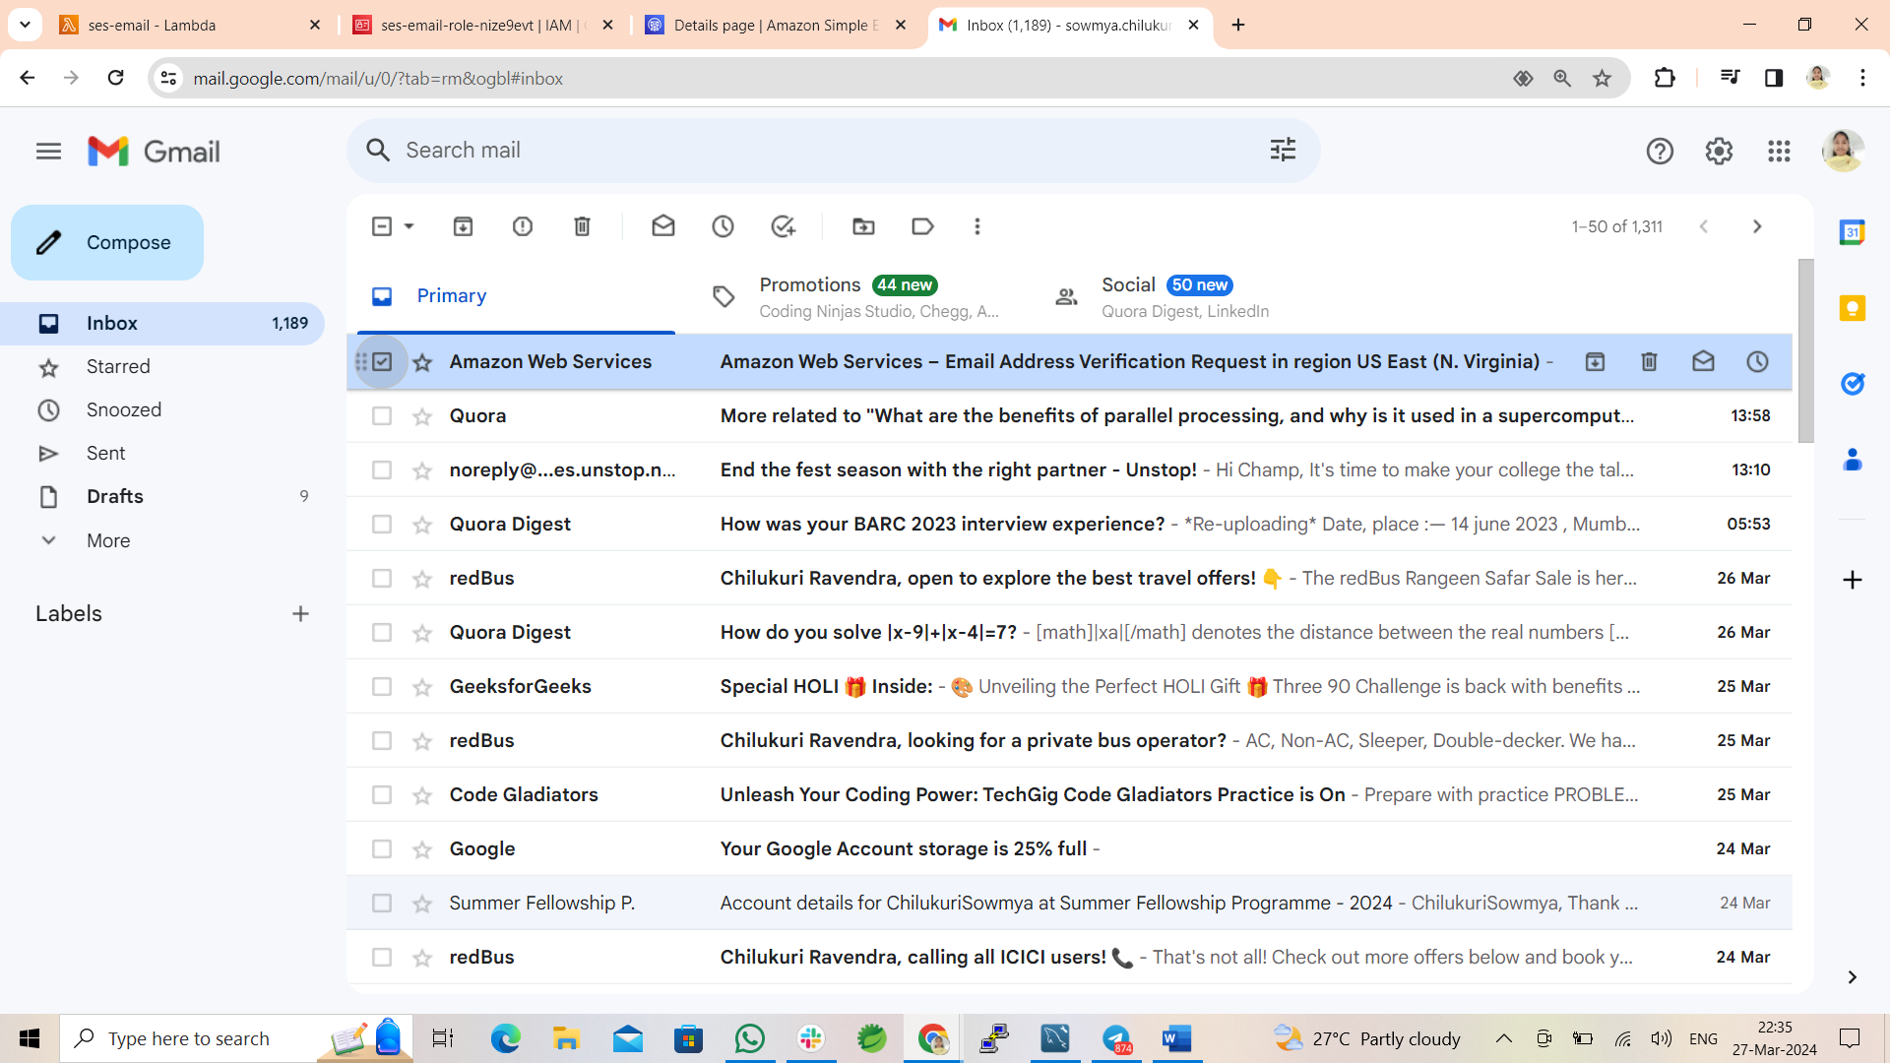
Step-6 : Verify Email

Slide 10
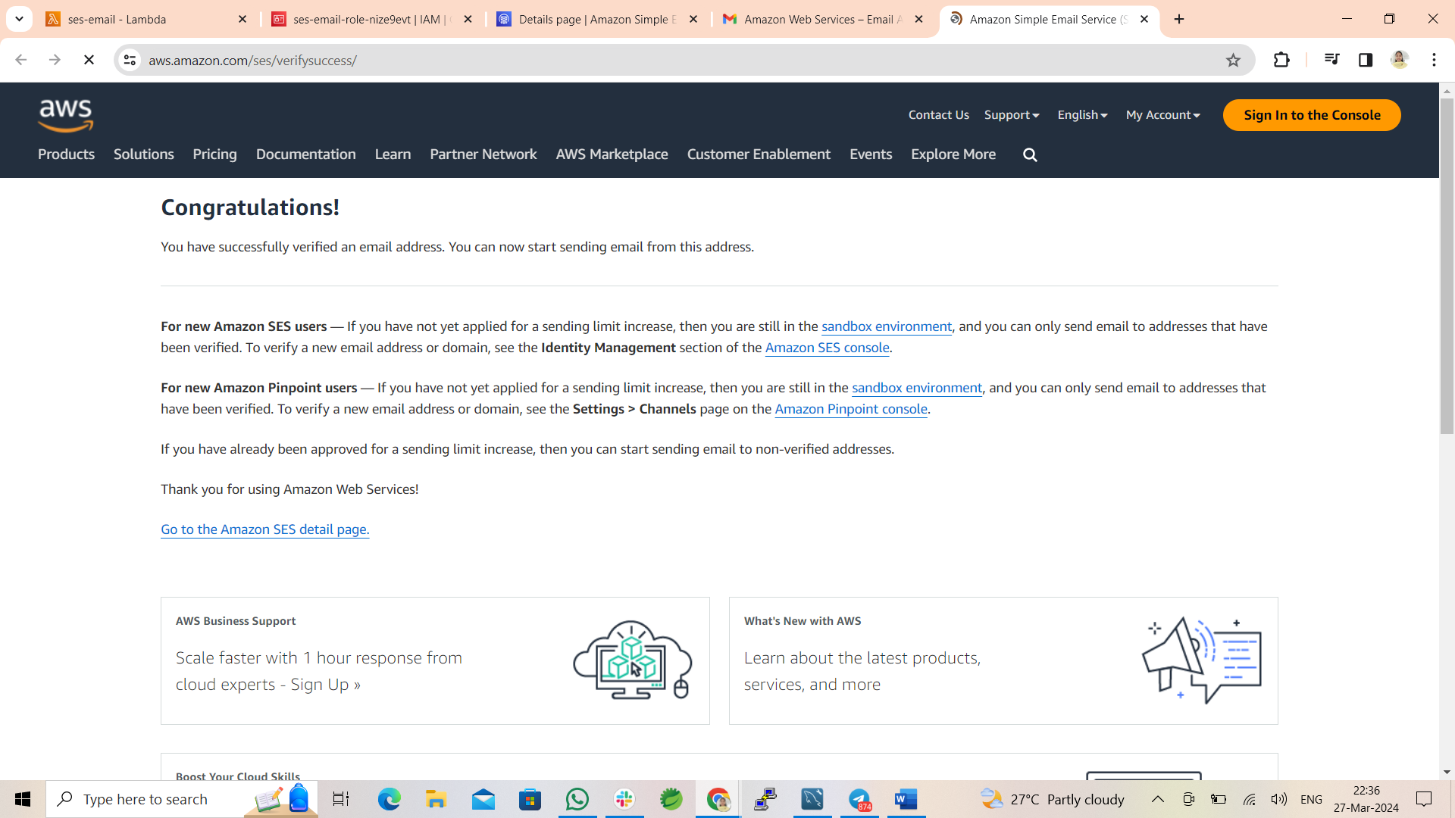
Verification of Email

Slide 11
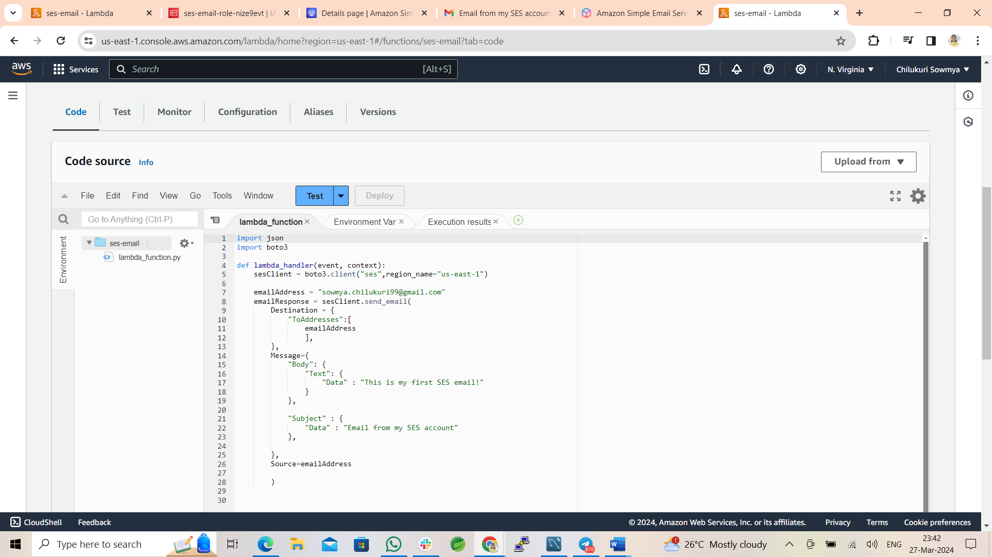
Step-7 : Write code and deploy changes

Slide 12
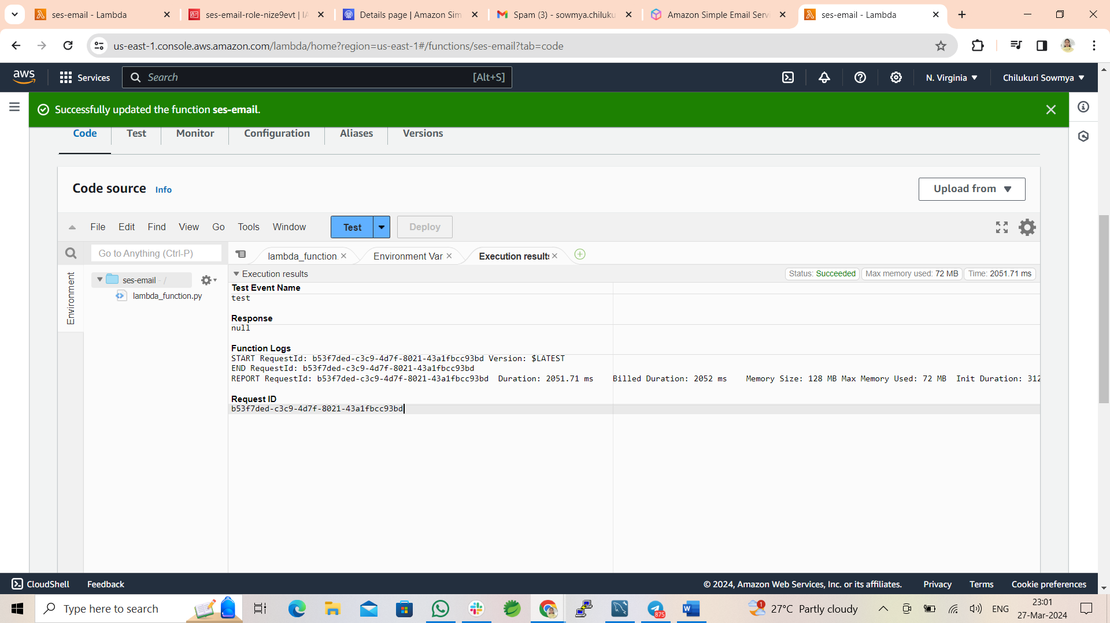
Execution Result :

Slide 13
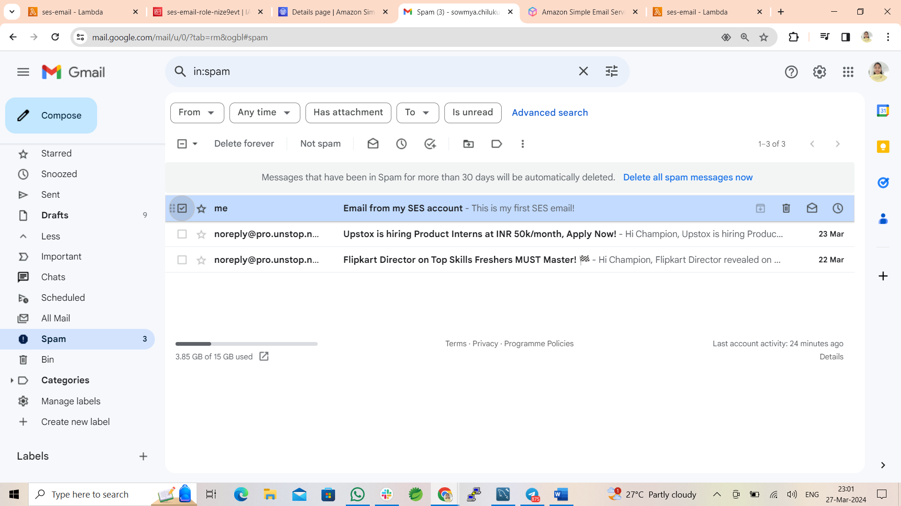
Check the Email

Slide 14
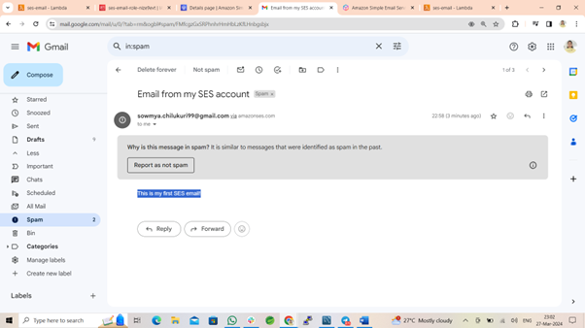
Final Output :

